Slide 1
Inventory Stock Order Forecasting @ Attridge Coop Food Store
Ajinkya Gole, Virgil Dsouza

Slide 2

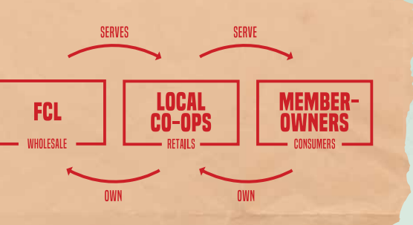
Introduction
Co-op Ownership
Spread across Western Canada
Individual Member ownership makes up Co-op. These are consumers themselves.
In last 5 years, Co-op has made $1.9 billion in patronage allocations
“Relationships are fundamental to this, between FCL and local Co-ops, between team members and leaders, between Co-op boards and strategic partners, and the list goes on….”
CEO Heather Ryan

Slide 3

Introduction
Importance
Co-op has over 65,000+ SKU’s, with the store having an average daily spend of $10K just on FMCG products.
Current Inventory ordering is done by utilizing the years of experience the senior supervisors have on the consumer behaviour and promotional offers for the week/month.
Traditional Methods
Re-order Point Technique
New Approach
ABC analysis using seasonal trends, historical sales and supplier lead time
Economic Order Quantity
Category wise distribution
Safety stock
Forecasting using ARIMA, XGBoost
LOCALLY INVESTED • COMMUNITY-MINDED • LIFETIME MEMBERSHIP BENEFITS • CARE FOR THE ENVIRONMENT

Slide 4
Literature Review
Inventory management is the continuing process of planning, organizing and controlling inventory that aims at minimizing the investment in inventory while balancing supply and demand.
A combined approach of ABC + XYZ is likely the most effective for the Grocery chain.
Inventory Forecasting using ARIMA is usually preferred for Short term forecasting.
Xgboost is useful for complex models where the relationships can be non-linear in nature.
Safety stock is a term used by logisticians to describe a level of extra stock that is maintained to mitigate risk of stock outs due to uncertainties in supply and demand

Slide 5
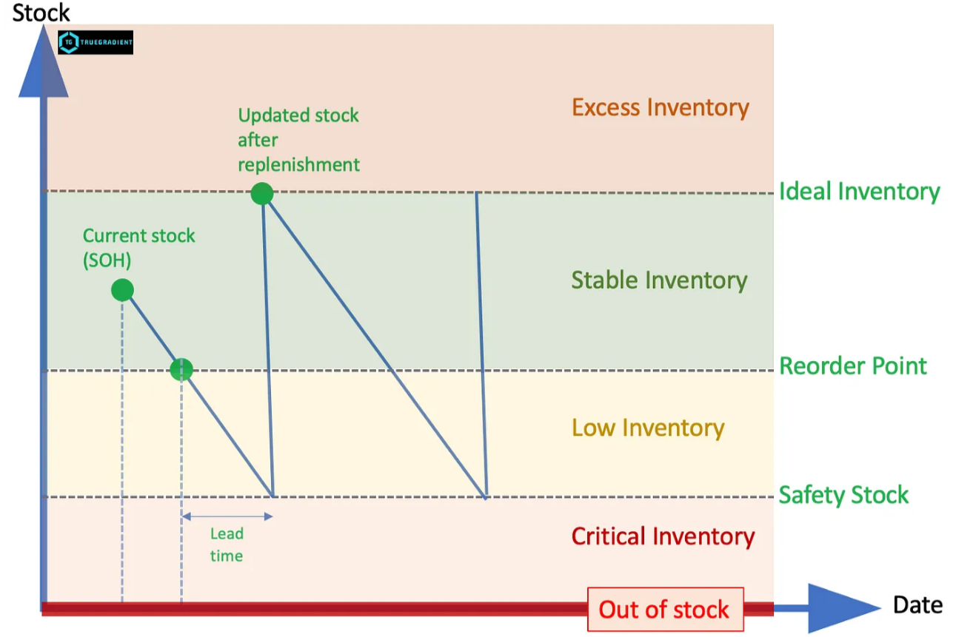
Problem Statement
To understand when do we reorder products based on the store’s inventory constraints like space available, supplier lead times and expiration dates of the products. (Excess Inventory issues)
Predicting Inventory order point, by forecasting products at SKU level using ARIMA (Autoregressive Integrated Moving Average) and XGBoost (Extreme Gradient Boosting)
To understand the Safety stock level by product and incorporating the need to balance it with the product expiration date

Slide 6
Research Questions/Objectives
Incorporate Stock Reorder Point for each SKU, using ARIMA (or) XGBoost to predict future demand.
Incorporate Safety stock level for each SKU, based on the product demand and average shelf life.

Slide 7
Methodology
Data Collection
Data Limitations: Historical Sales Data over past 12 months and Inventory levels by each day.
Data Cleaning
Data set allocation: We will be using Dataset from September 2023 to September 2024 as Training Dataset and September; November 2024 dataset will be our Test Dataset.
Software Used: JD Edwards System, MS Excel and Python.
Variables that will be encountered are
PLU Number
Department (Category) and Sub Department
Unit Cost, Quantity, Price
New variables such as Rolling statistics for Sales Quantity, Daily Weather data, Discount data and Days split by date.

Slide 8
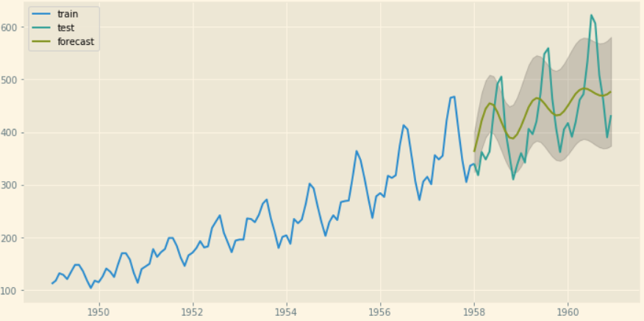
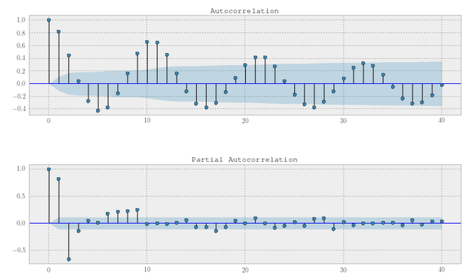
Data Modelling
Model 1
AutoRegressive Integrated Moving Average (ARIMA) model is used for demand forecasting.
Handles time series data well.
Clear Trend line can be drawn.
We plot Autocorrelation function (ACF) and Partial Autocorrelation Function (PACF) that will help in visualizing how past observation correlates with the current one.
Model Evaluation metrics to be used Mean Absolute Error, Root Mean Square error etc.
Notes:
https://stats.stackexchange.com/questions/139796/autocorrelation-and-partial-correlation-plots-in-arma-models

Slide 9
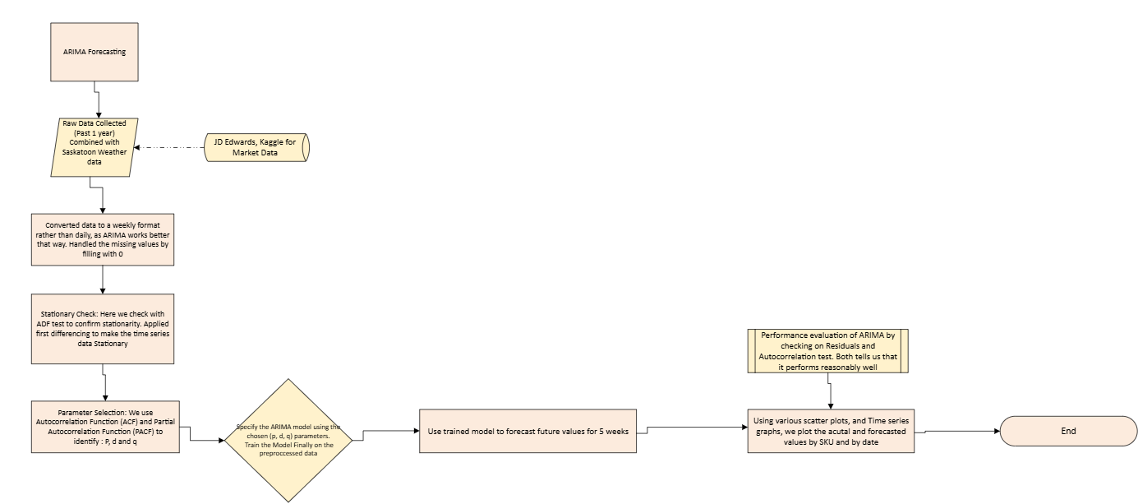
Flow Charts

Slide 10
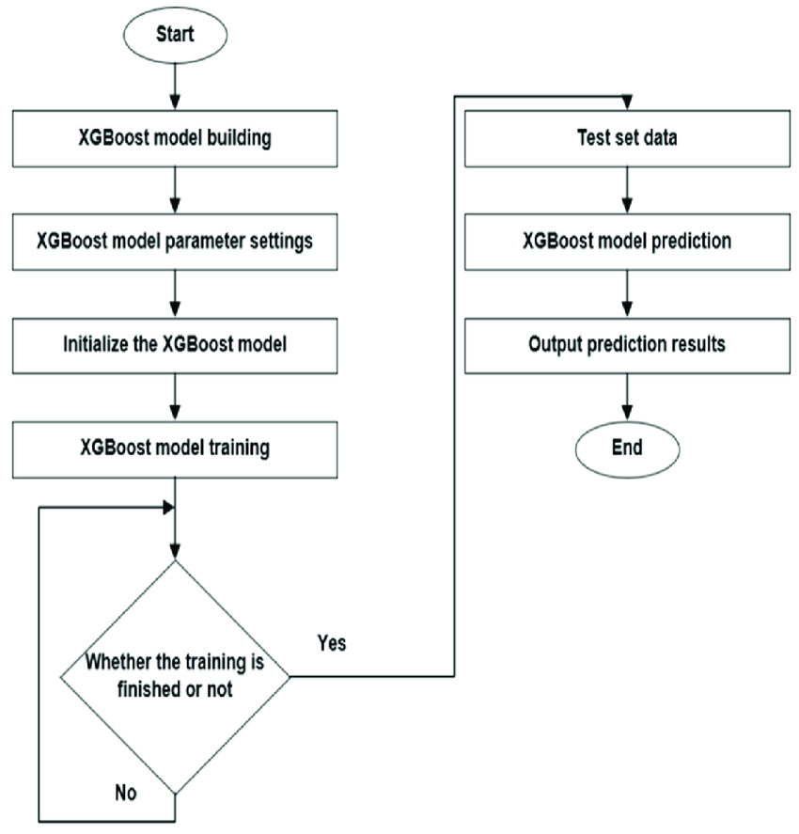
Data Modelling
Model 2
XGBoost (Extreme Gradient Boosting) would require the time series data to be converted into actual columns. Like “sale from previous day”, “sale from week ago” etc.
XGBoost can handle outside factors such as promotional events, price drops etc. that might influence the sales.
Also, while being better prepared to handle missing data, it is also good in incorporating rolling statistical numbers like lead time, demand nonlinearity.
Notes:
Li, Tingxia & Li, Tiankai & Su, Rina & Xin, Jile & Han, Ding. (2023). Classification and Recognition of Goat Movement Behavior Based on SL-WOA-XGBoost. Electronics. 12. 3506. 10.3390/electronics12163506.

Slide 11
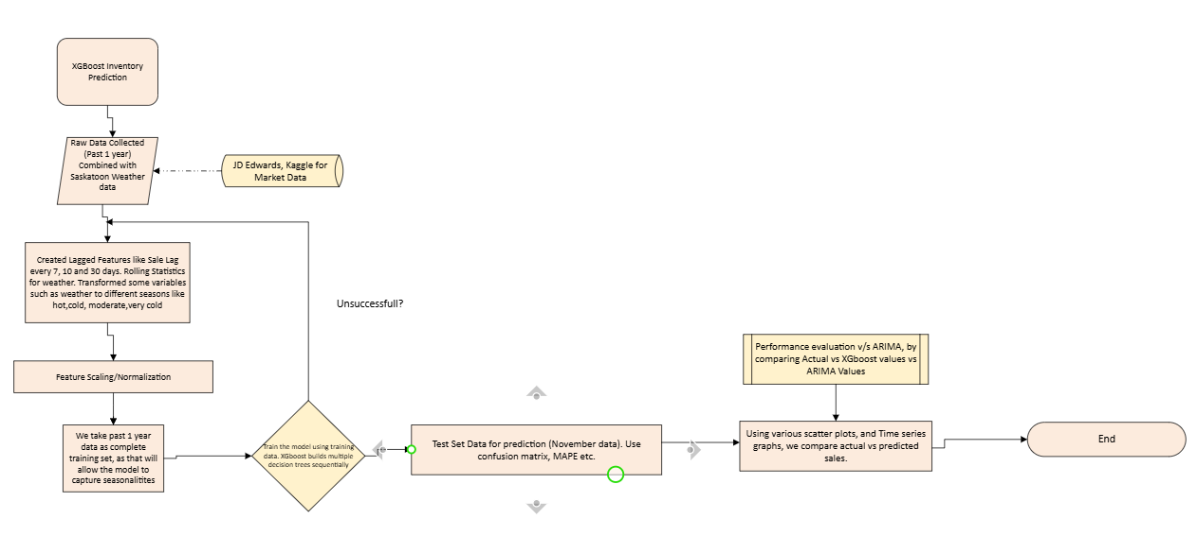
Flow Charts

Slide 12
Initial Graphs

Slide 13
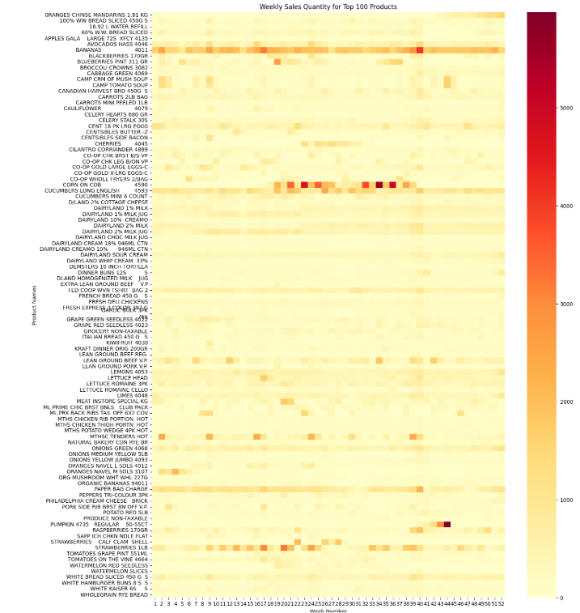

Slide 14
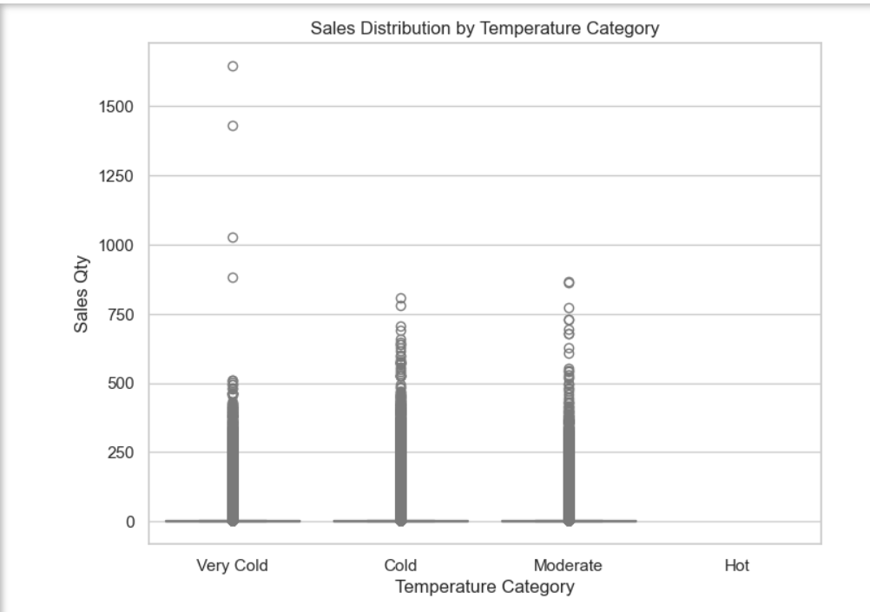

Slide 15
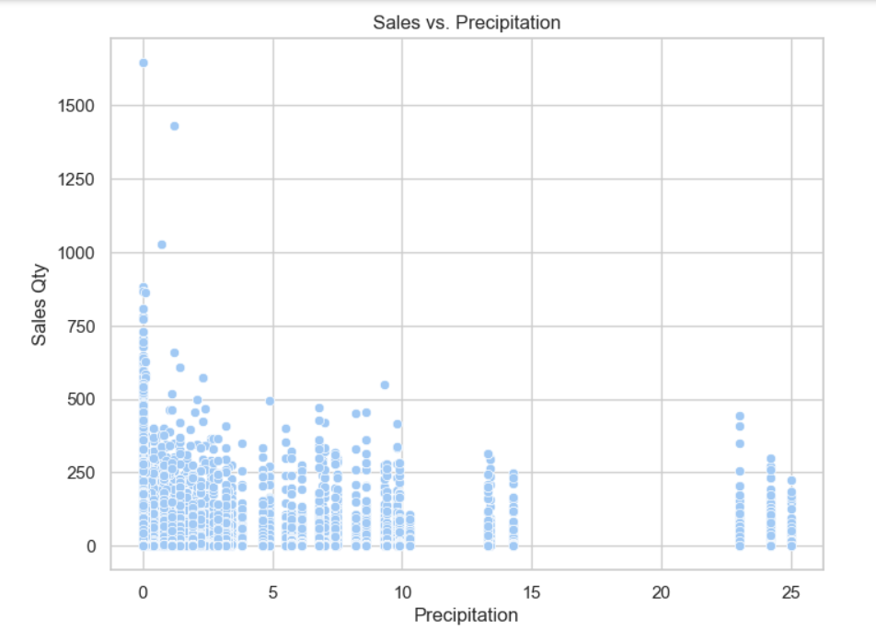

Slide 16
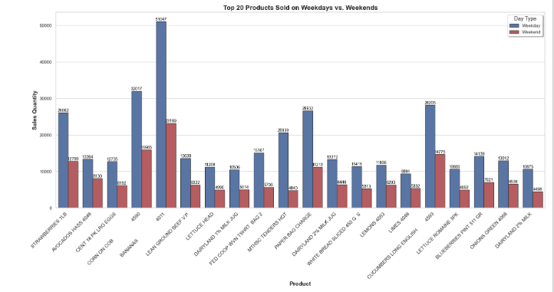

Slide 17
Libraries Used
from statsmodels.tsa.stattools import adfuller
from statsmodels.graphics.tsaplots import plot_acf, plot_pacf
from statsmodels.tsa.arima.model import ARIMA
from sklearn.model_selection import train_test_split
from sklearn.metrics import mean_squared_error
from sklearn.preprocessing import MinMaxScaler
from sklearn.metrics import mean_absolute_error
from sklearn.metrics import confusion_matrix, ConfusionMatrixDisplay
import xgboost as xgb

Slide 18
ARIMA
Modelling and Evaluation

Slide 19
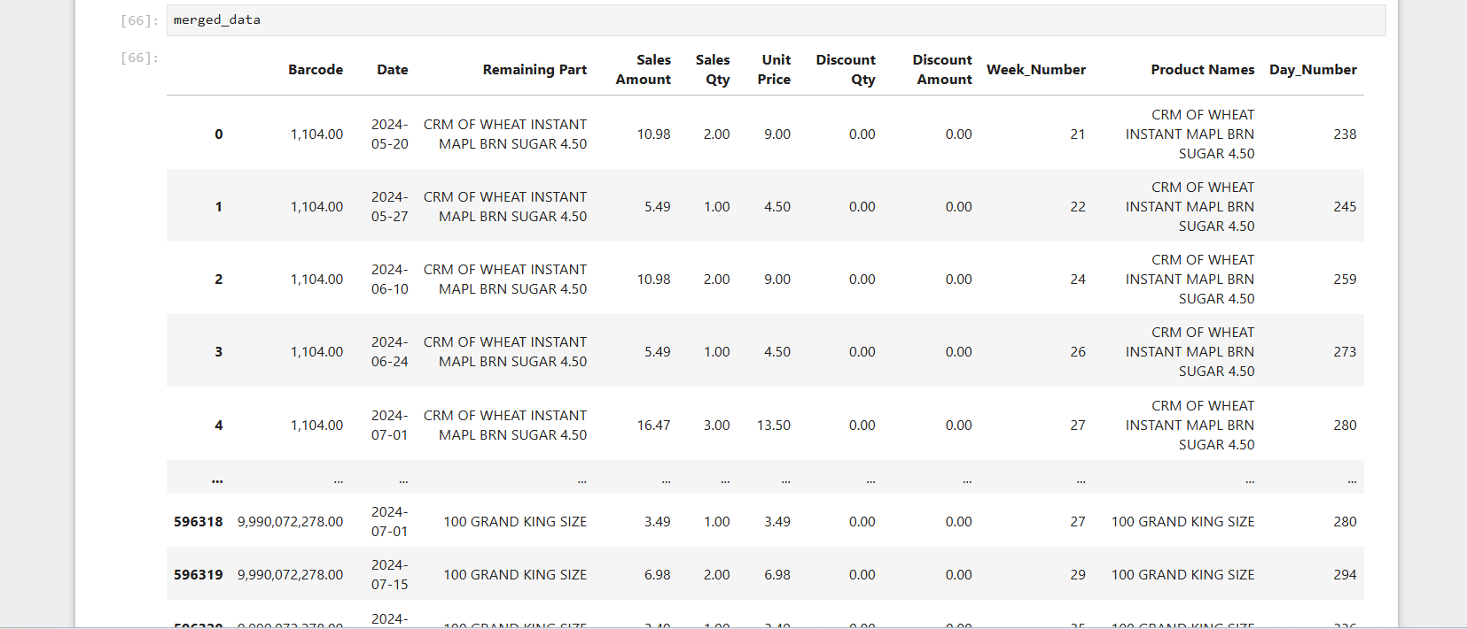
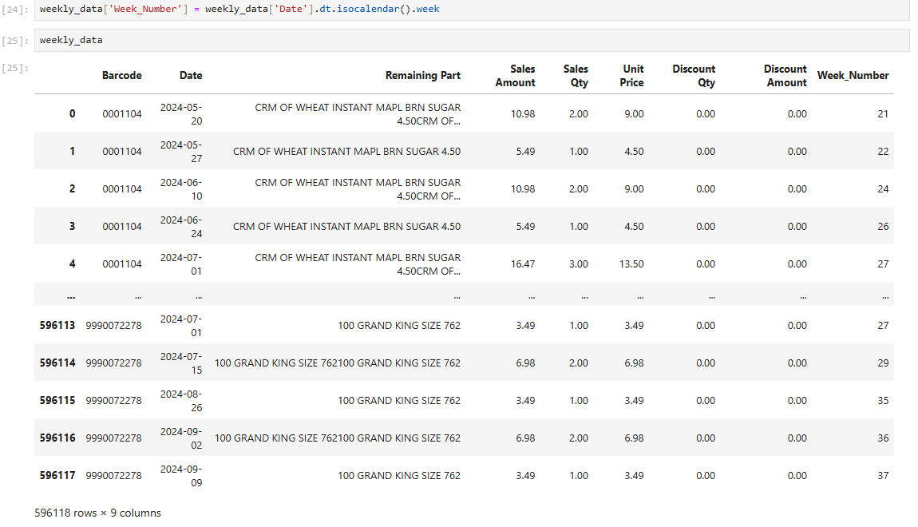

Slide 20
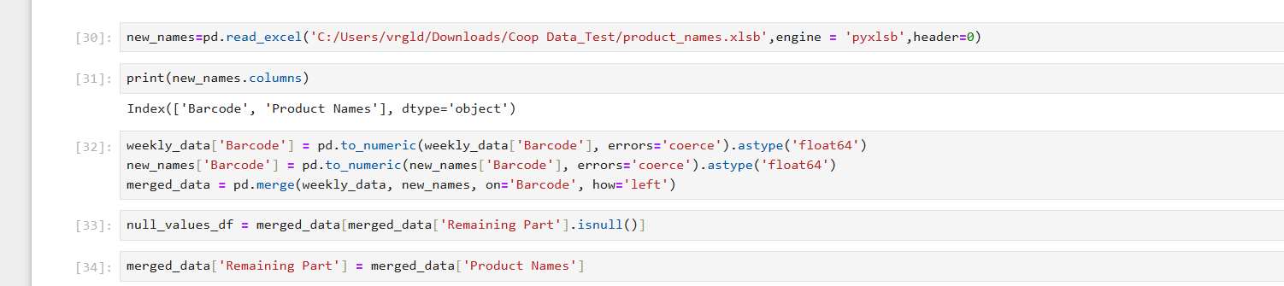
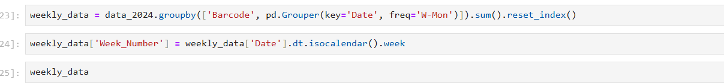
Aggregated data based on Barcode and grouped it weekly (7days)

Slide 21
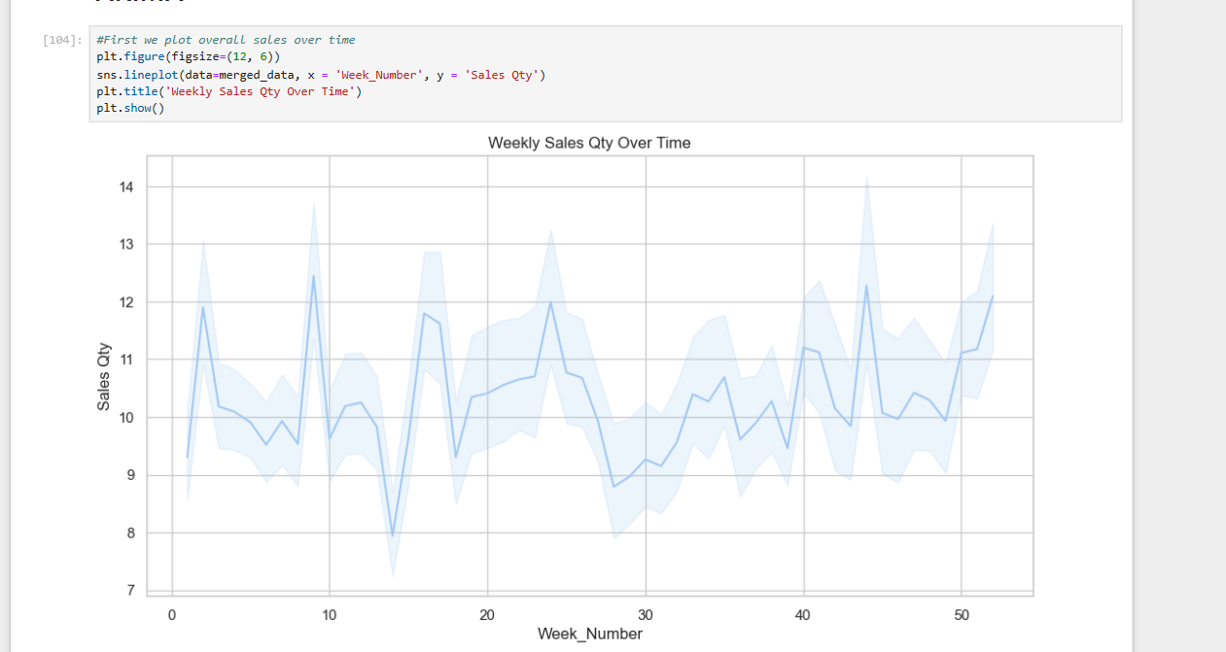
Demand is fluctuating depending on factors such as weather, promotions etc.
We would most likely need to use first order differencing here, as there is clear seasonality spikes

Slide 22
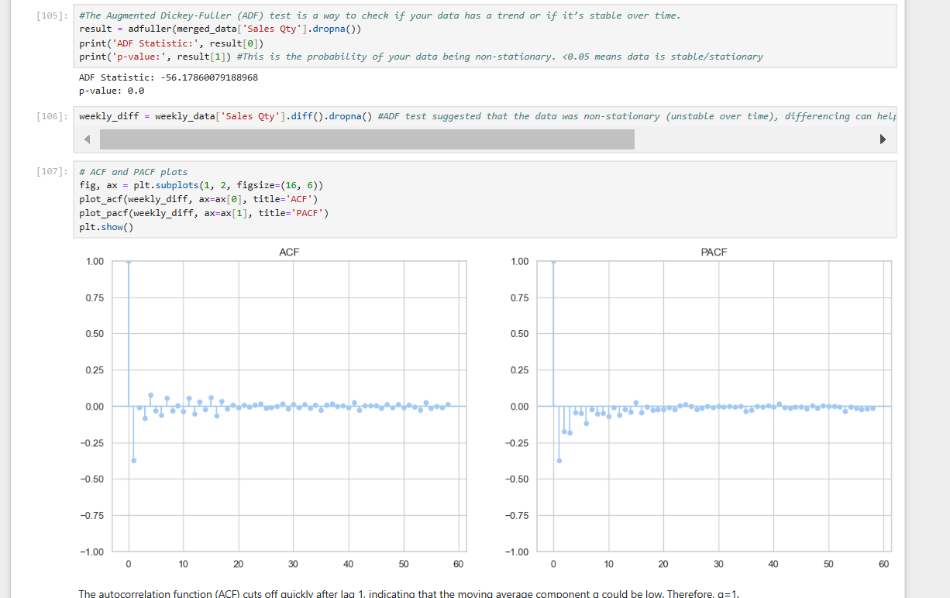
p = How many previous values (lags) affect the data
d = How many times you need to "difference" the data to make it stationary
q = How many past errors (mistakes in prediction) affect the data.
The ADF test and p value tell us that the data is stationary, but we also see that seasonality exists.
Autocorrelation test and Partial ACF tells us basically if the data is related to itself at different points of time
This tell us there is not much dependency in the data, which is good.

Slide 23
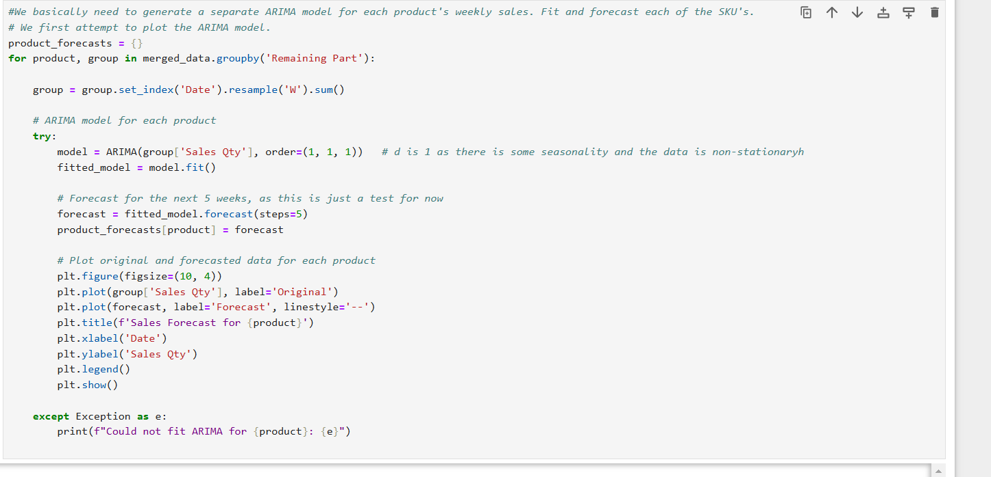
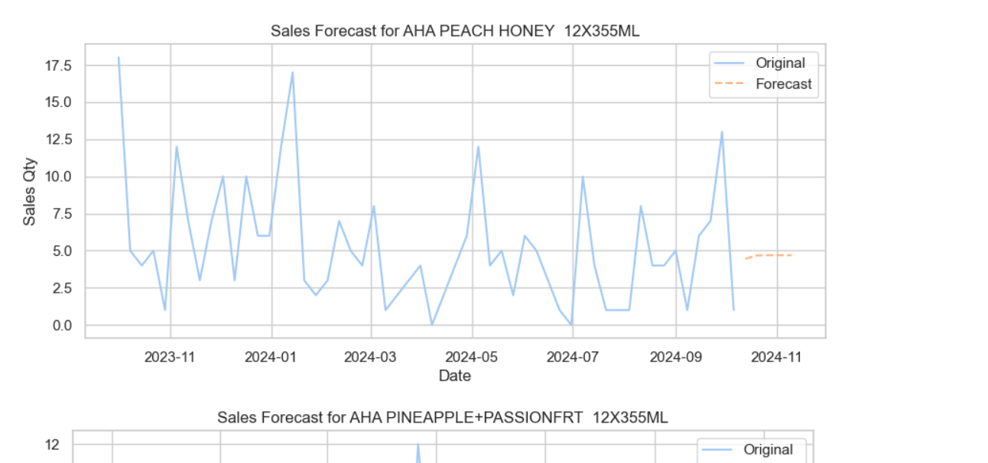

Slide 24
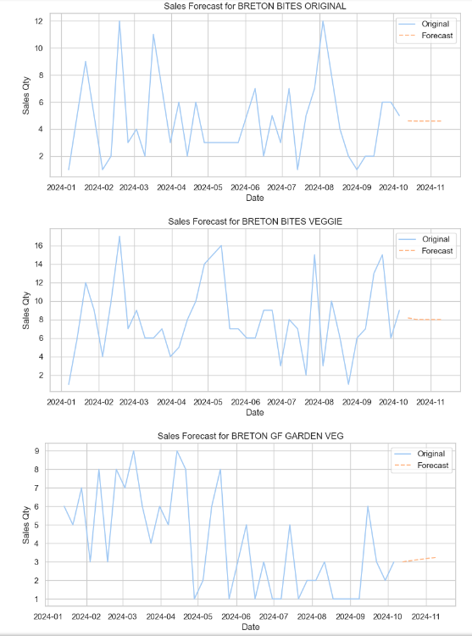

Slide 25
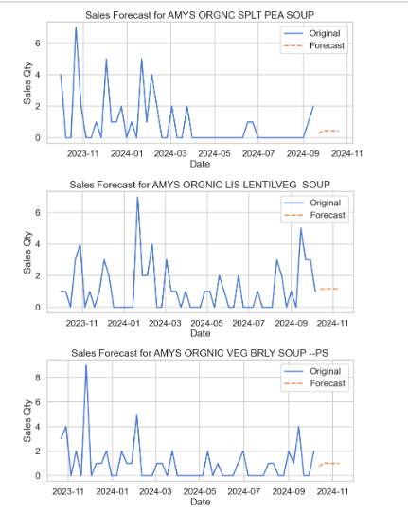
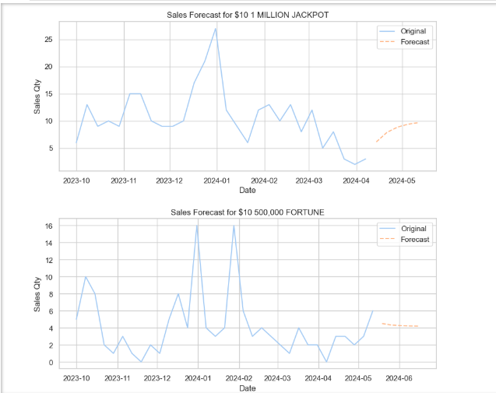

Slide 26
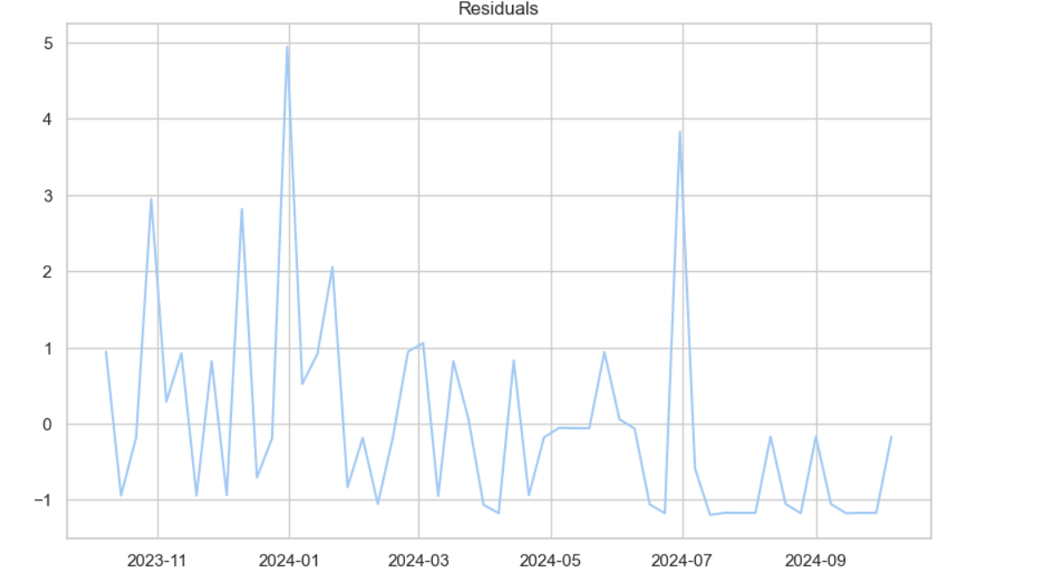
The residual plot shows noticeable cyclical patterns, which suggest that the ARIMA model may not have fully captured all underlying trends or seasonality in the data.
Ideally should be random noise.
In this plot, while many of the residuals hover around zero, the spikes might suggest specific time periods where the model's performance was poor.

Slide 27
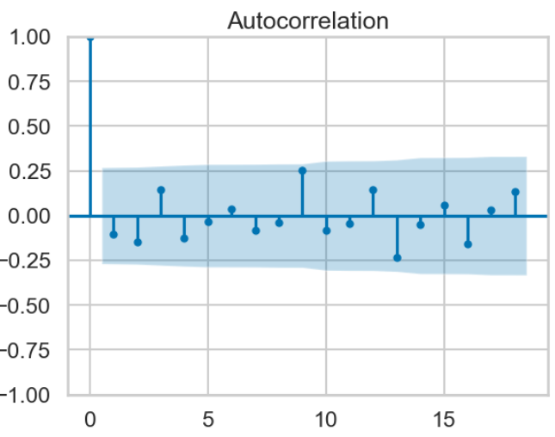
Except at the beginning, the correlations at subsequent lags quickly drop close to zero.
The blue shaded area represents the 95% confidence interval. Any correlation that falls within this area is considered statistically insignificant.
ARIMA model is working well, as the residuals are mostly uncorrelated and behave like random noise

Slide 28
Extreme Gradient Boosting (XGBoost)
Modelling and Evaluation

Slide 29
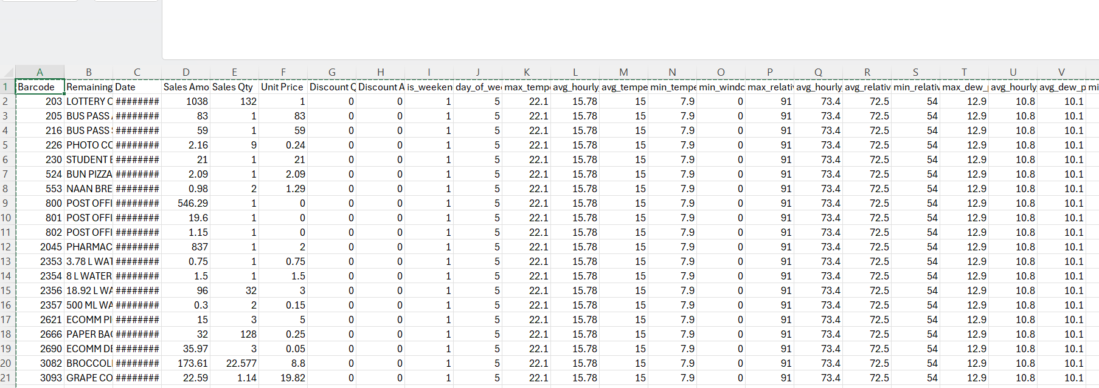
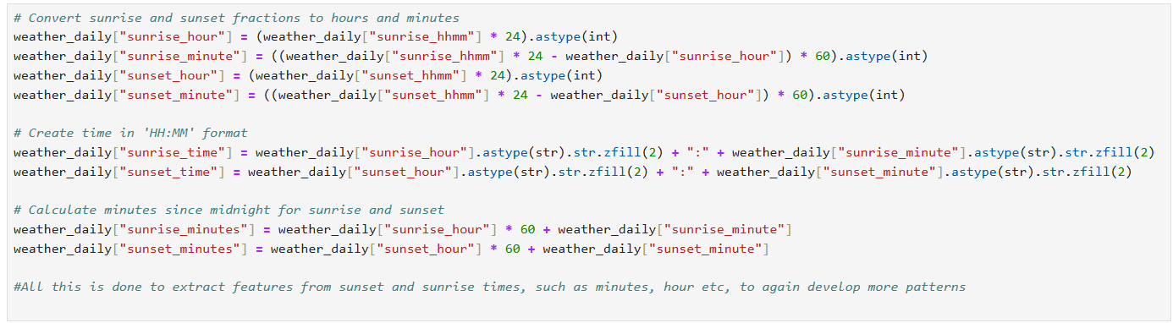
We have incorporated atleast 60 input features, which are a combination of weather data, weekend flag and partial discount data.

Slide 30
Barcode
Remaining Part
Date
Sales Amount
Sales Qty
Unit Price
Discount Qty
Discount Amount
is_weekend
day_of_week
max_temperature
avg_hourly_temperature
avg_temperature
min_temperature
min_windchill
max_relative_humidity
avg_hourly_relative_humidity
avg_relative_humidity
min_relative_humidity
max_dew_point
avg_hourly_dew_point
avg_dew_point
min_dew_point
max_wind_speed
avg_hourly_wind_speed
avg_wind_speed
min_wind_speed
max_wind_gust
wind_gust_dir_10s
max_pressure_sea
avg_hourly_pressure_sea
avg_pressure_sea
min_pressure_sea
max_pressure_station
avg_hourly_pressure_station
avg_pressure_station
min_pressure_station
max_visibility
avg_hourly_visibility
avg_visibility
min_visibility
heatdegdays
cooldegdays
growdegdays_5
growdegdays_7
growdegdays_10
precipitation
snow_on_ground
sunrise_hhmm
sunset_hhmm
daylight
min_high_temperature_forecast
max_high_temperature_forecast
min_low_temperature_forecast
max_low_temperature_forecast
sunrise_hour
sunrise_minute
sunset_hour
sunset_minute
sunrise_time
sunset_time
sunrise_minutes
sunset_minutes

Slide 31
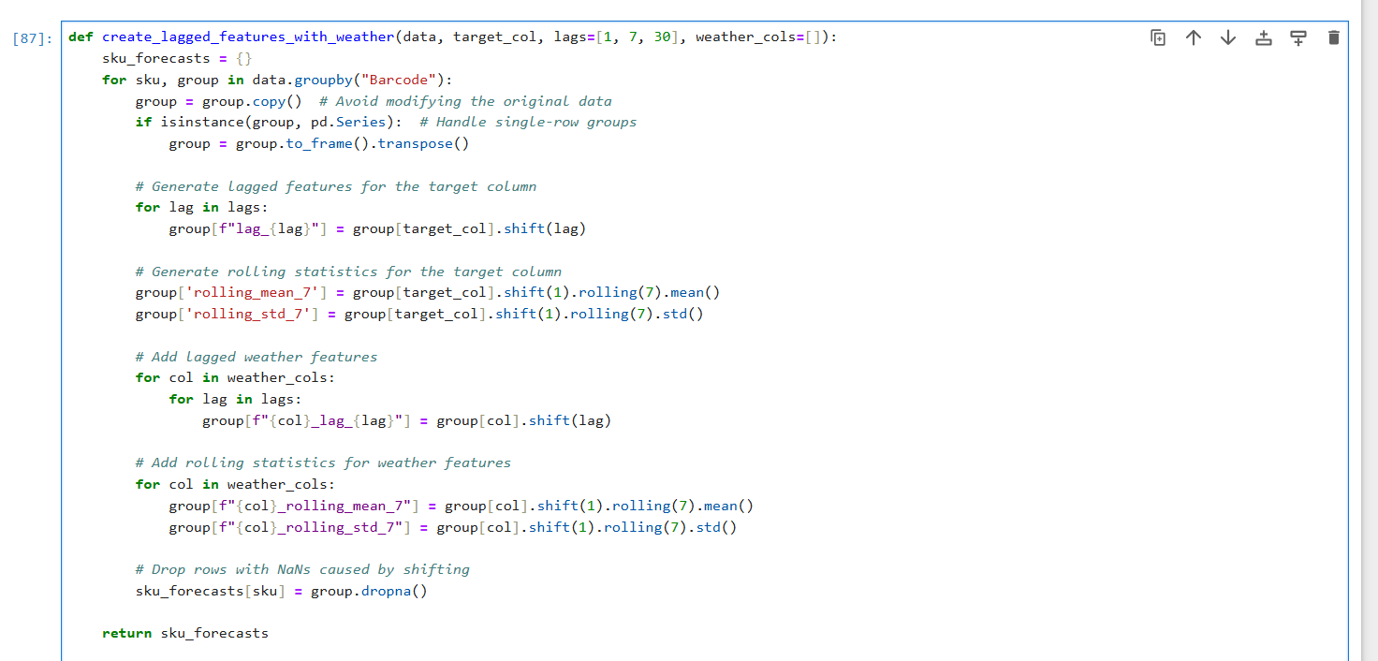

Slide 32
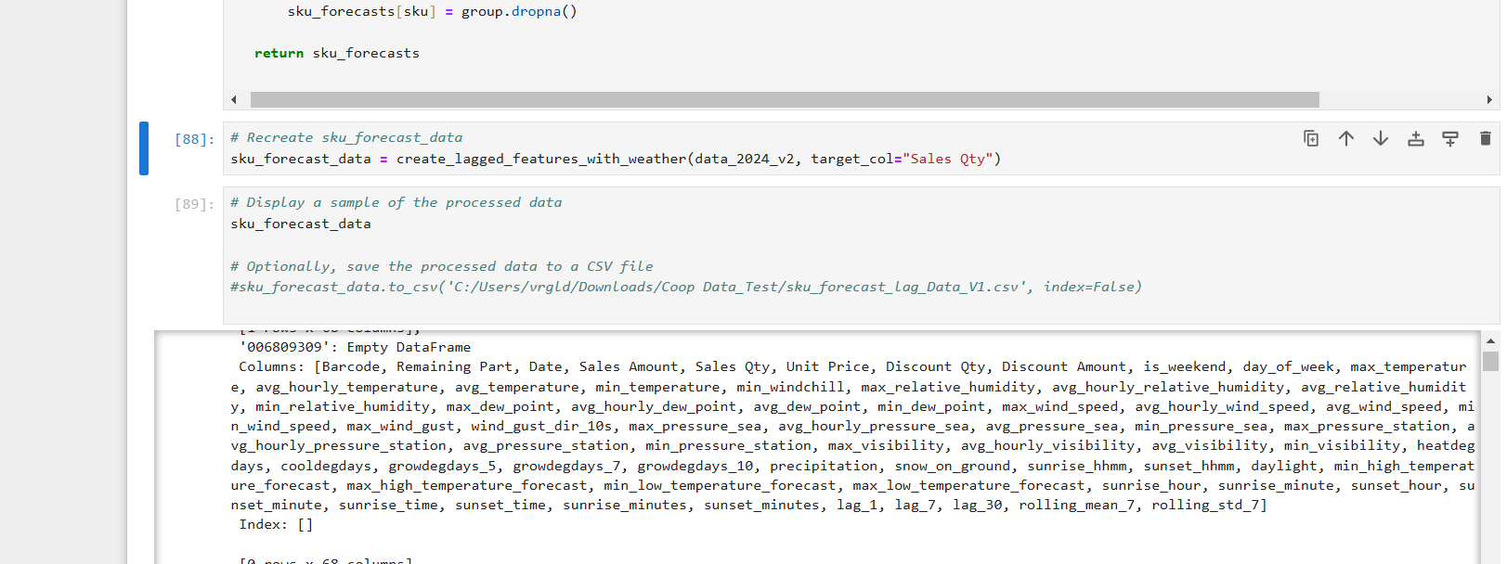
Creates lagged features for target column, Sales Quantity for each SKU.
Also creates rolling averages and standard deviations to capture trends
Incorporating lagged weather and their rolling statistics.
We also drop any rows which don’t have data or is Nan.
This is essentially converting the data into a more time-series forecasting form

Slide 33
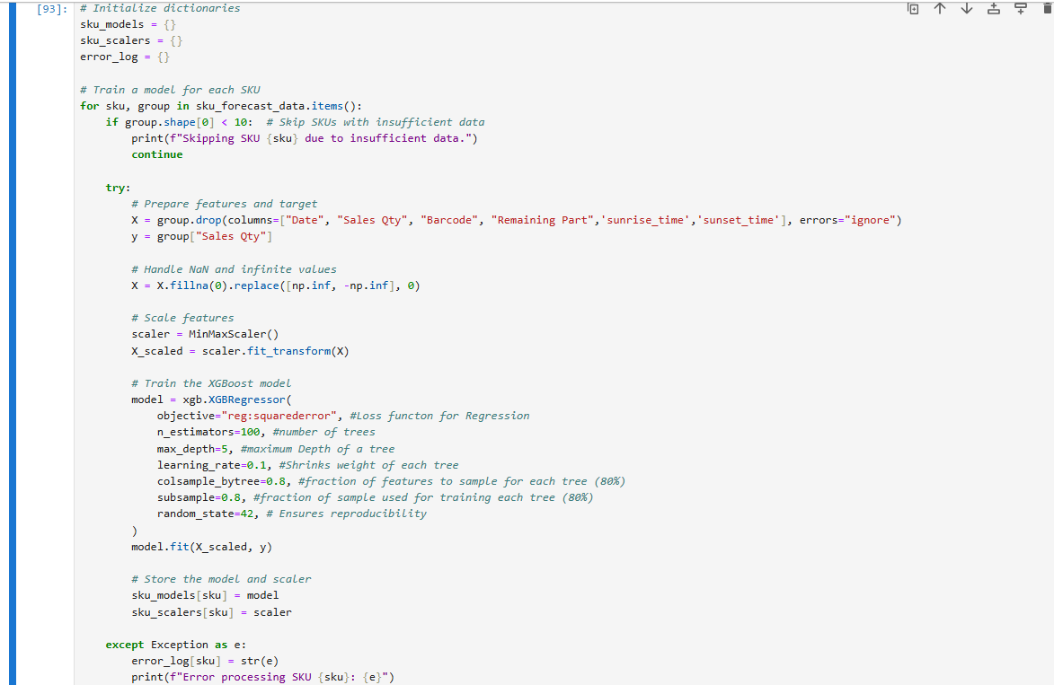
Manually Chose the Hyper Parameters for now during configuration!
We should be using GridsearchCV for this, but less memory!!!
We skip the rows or SKU’s which have less than 10 rows, as past history showed that it gives us bad data.
Using Scalar to get data between 0 and 1.
We save the trained model and its scaler so we can use them later to predict sales for this SKU.
Further tuning of hyperparameters is needed, using techniques like grid search, random search, or Bayesian optimization to find the best combination.

Slide 34
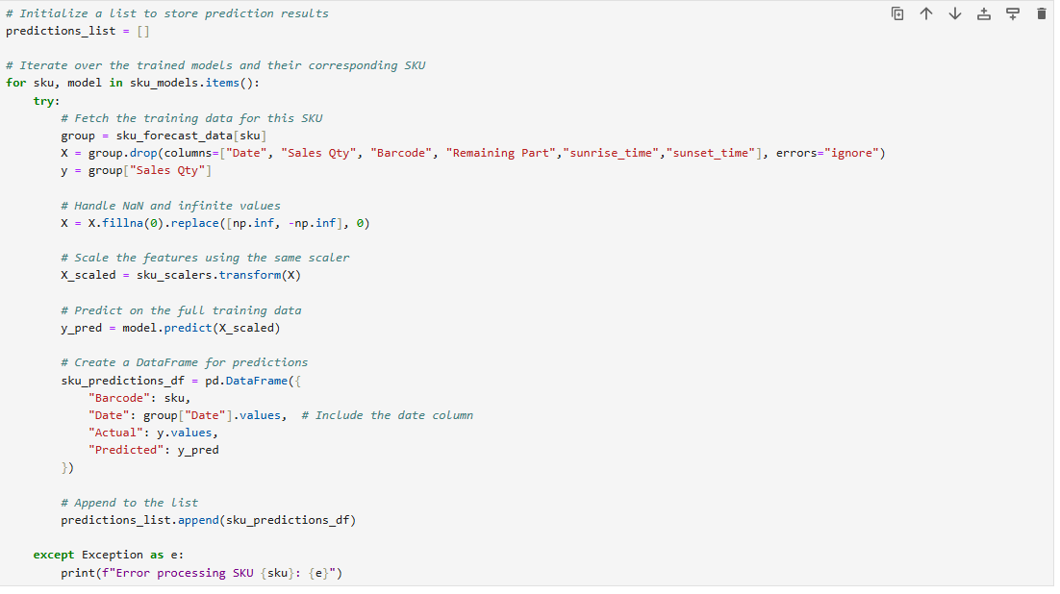

Slide 35
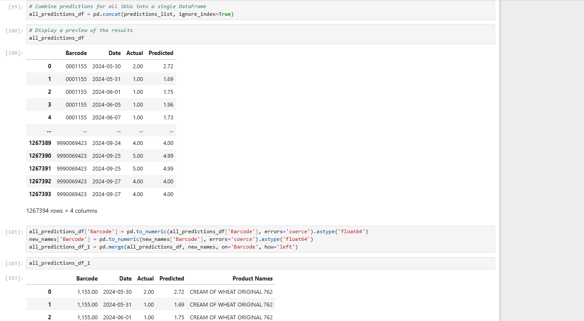

Slide 36
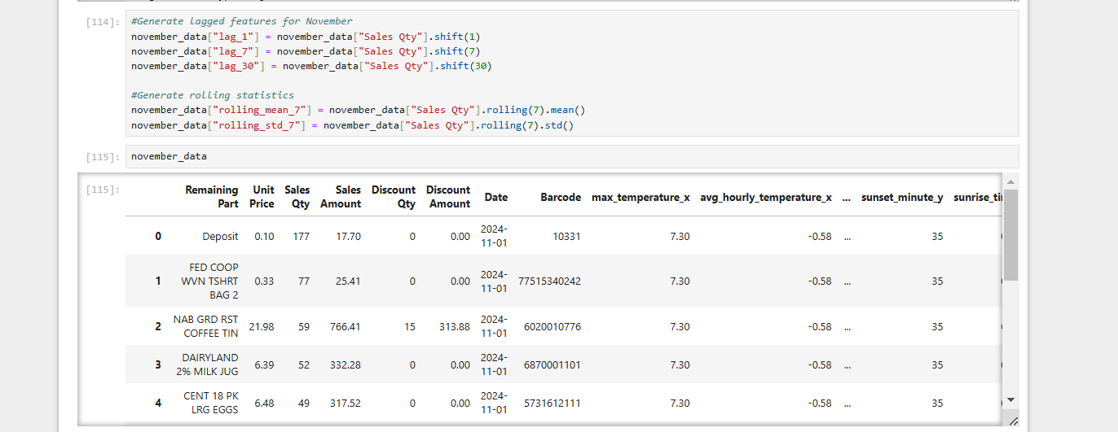
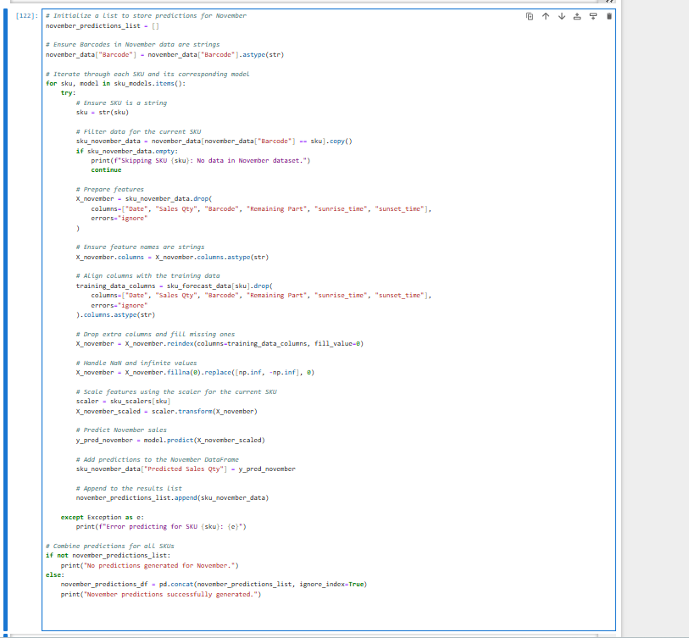

Slide 37
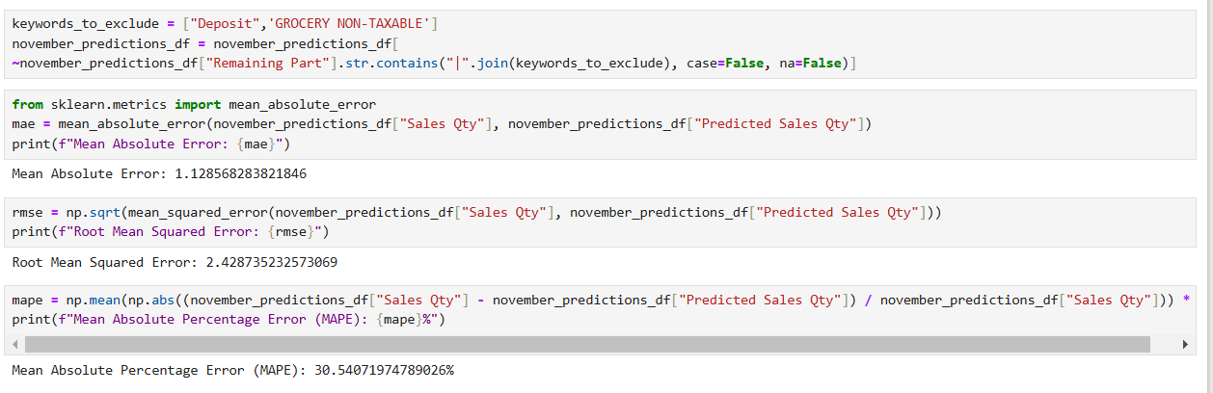
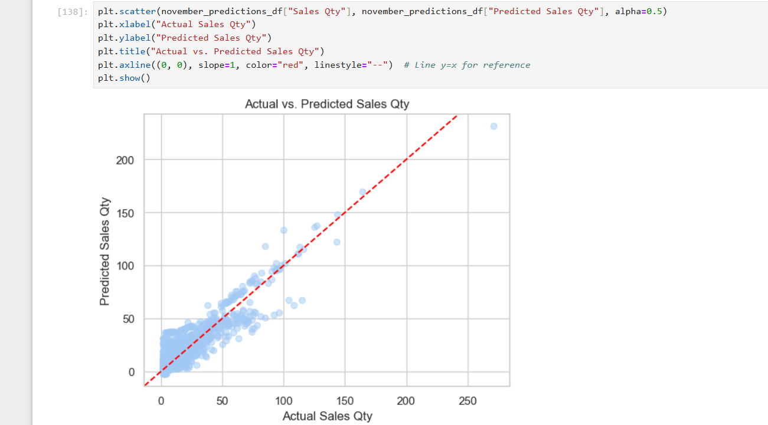
The error margins (MAE ~1.13 and RMSE ~2.43) indicate that your model performs reasonably well for absolute sales prediction.
MAPE of 30.54% is moderate.
The scatter plot confirms that the model captures the general trend of sales reasonably well
The model is not perfect for unusual sales, but that can be rectified with increase in data points

Slide 38
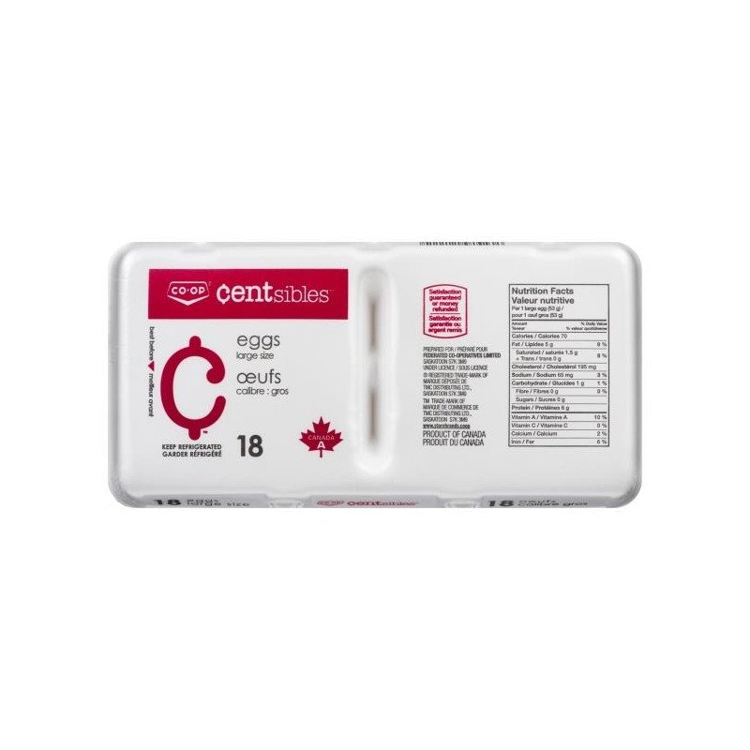
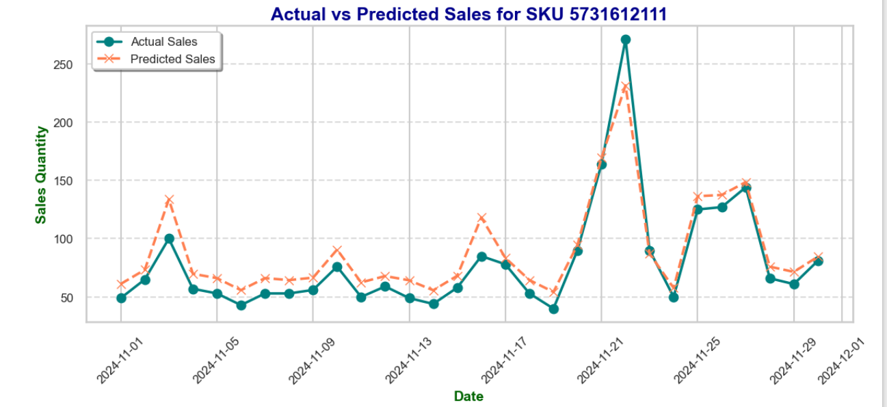

Slide 39
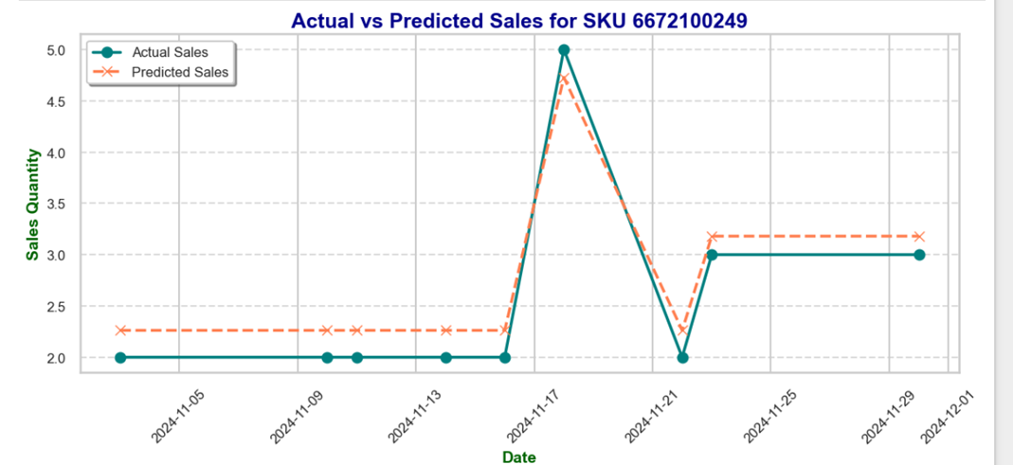

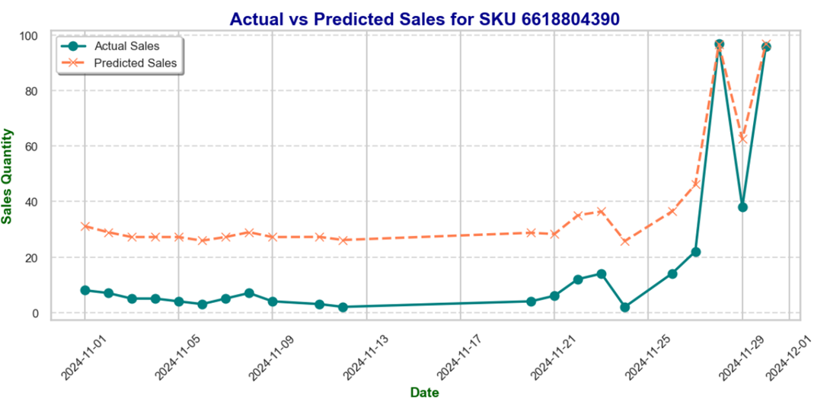
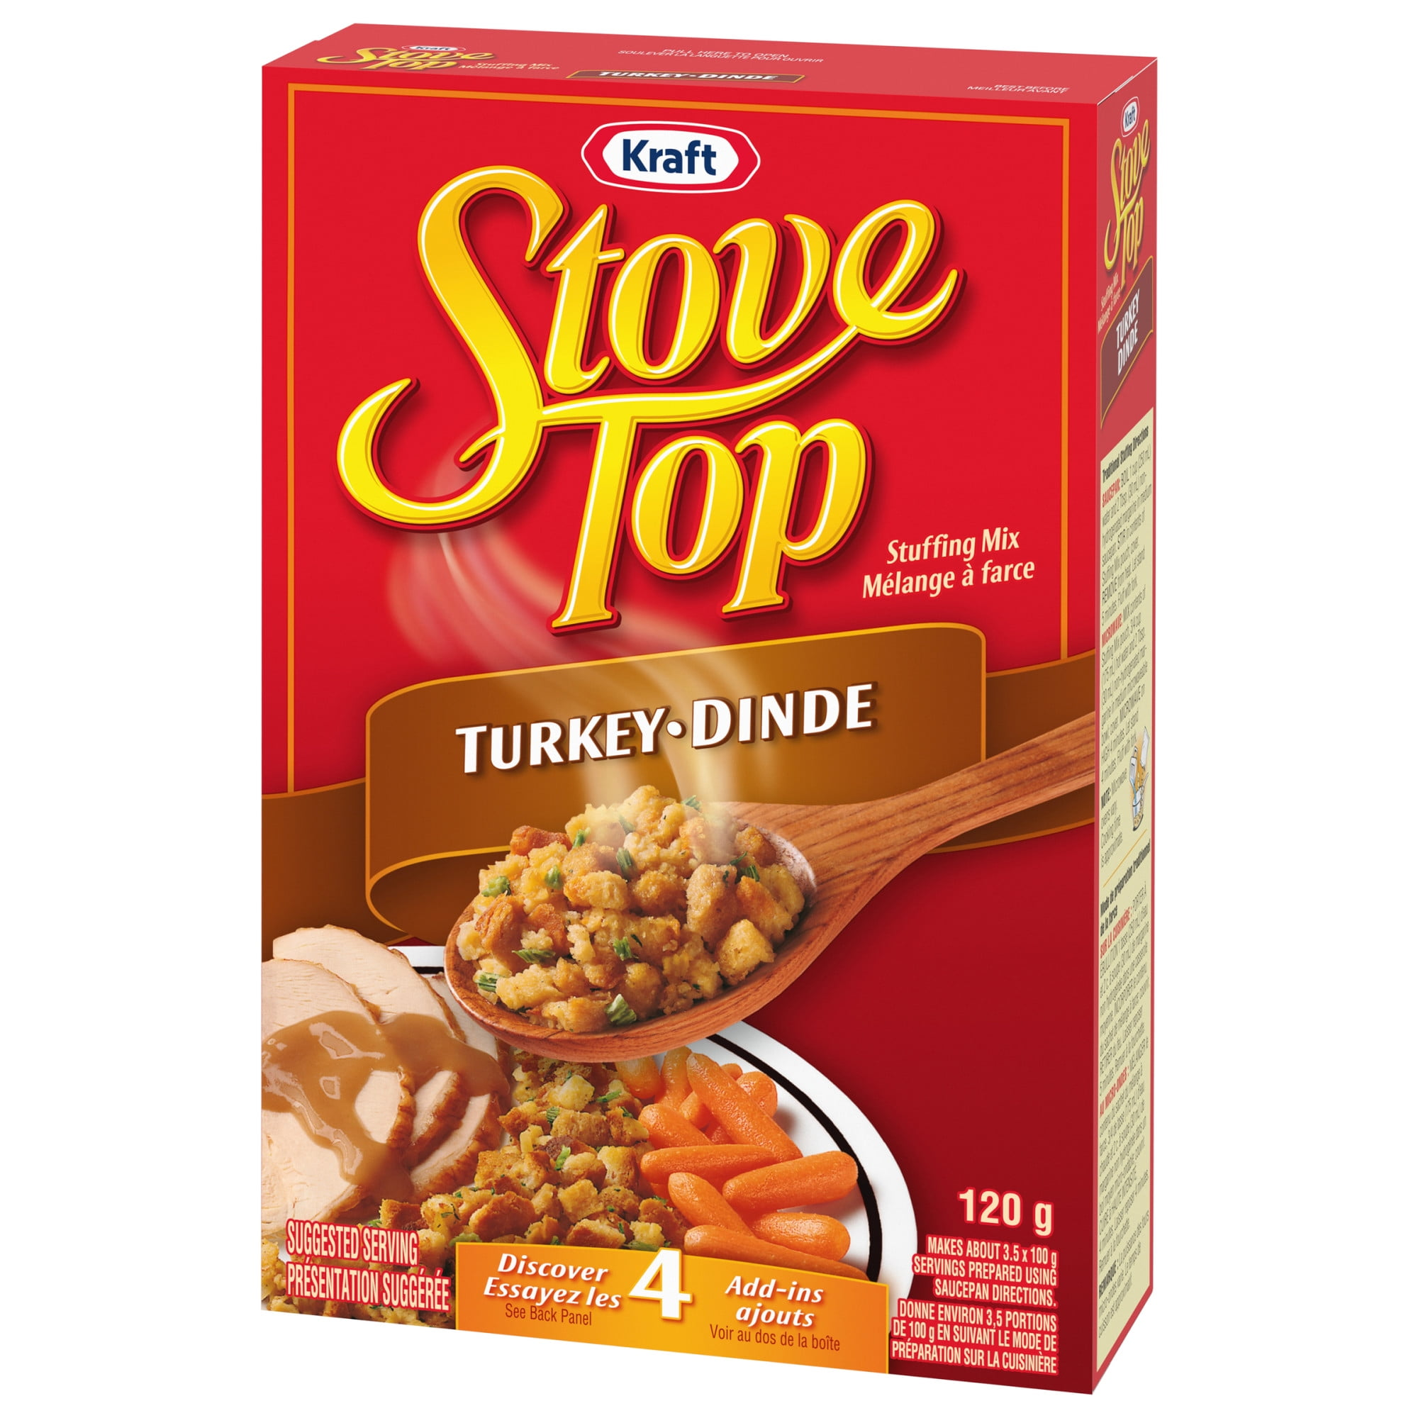
D

Slide 40
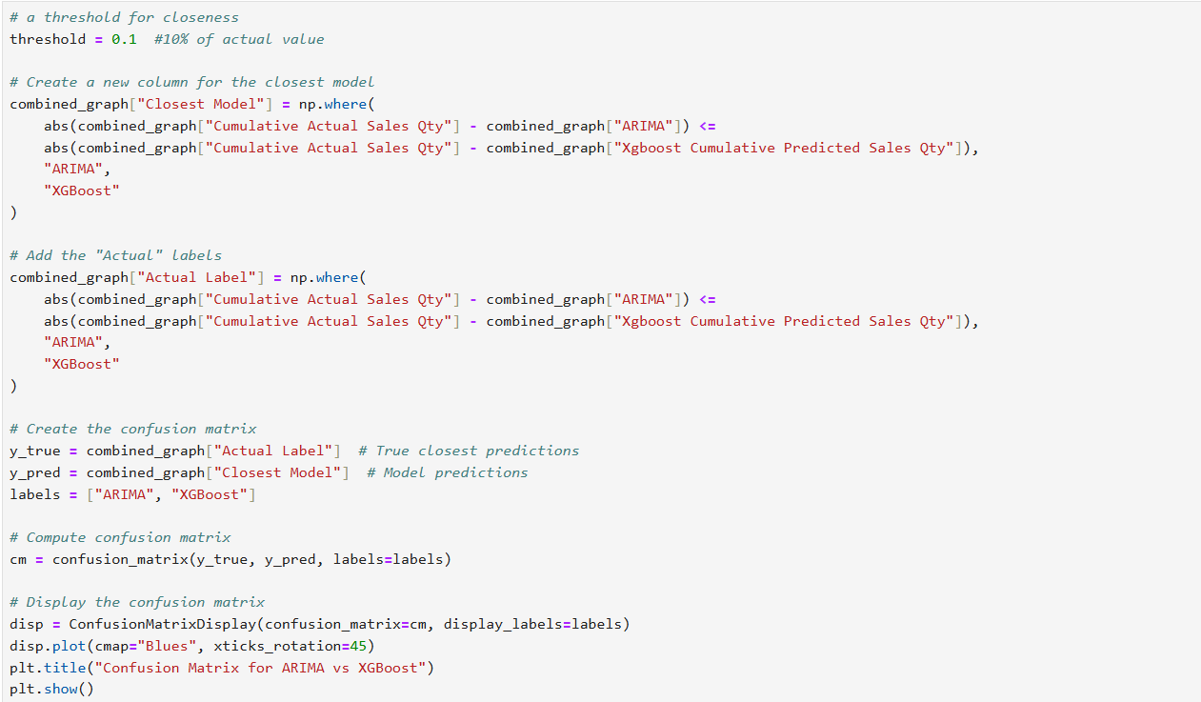
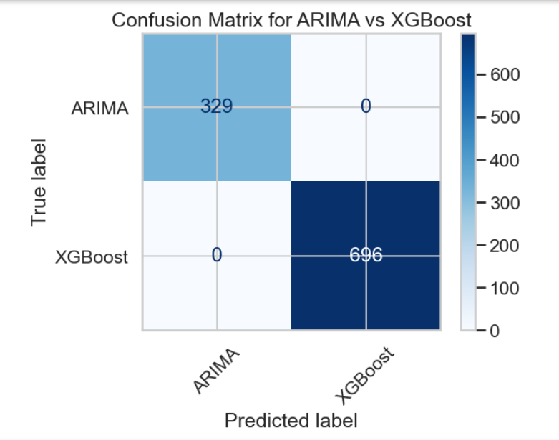
For each row in the dataset, the absolute difference between the actual sales and ARIMA predictions is compared to the absolute difference between the actual sales and XGBoost predictions.
The matrix shows that XGBoost outperformed ARIMA in 696 cases, whereas ARIMA performed better in 329 cases

Slide 41
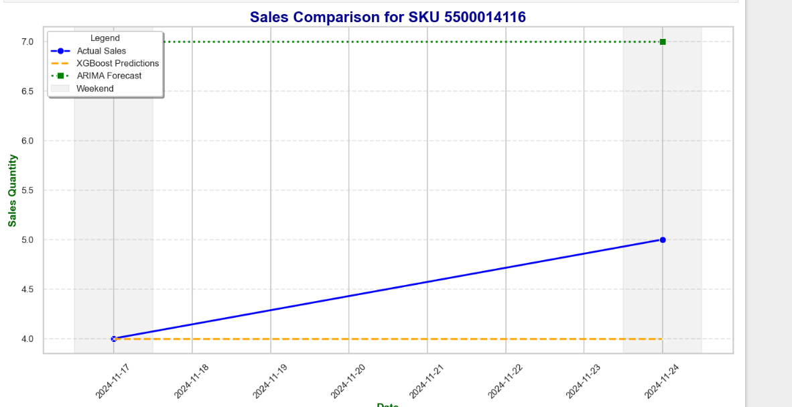


Slide 42
Limitations of the Study
Missing data on products due to legacy data not being updated
Modelling will be limited to supplier-based products. Products from the Deli section, Produce section won’t be considered
Data constraints due to recent cyber attack

Slide 43
Conclusion
“Companies pay too much attention to the cost of doing something. They should worry more about the cost of not doing it”
Philip Kotler

Slide 44
This analysis highlights XGBoost in capturing complex relationships in the data, while ARIMA excelled in scenarios where seasonality was consistent.
Manually defined hyperparameters performed reasonably well, no hyperparameter tuning was conducted, leaving room for further optimization.
XGBoost outperformed ARIMA in handling noisy or complex data, where relationships between features and target values were less explicit
The XGBoost model demonstrated strong predictive performance, achieving a Mean Absolute Error (MAE) of 1.13, a Root Mean Squared Error (RMSE) of 2.42, and a Mean Absolute Percentage Error (MAPE) of 30.54%

